Slide 1

Foundations of Cryptography security definitions, arbitrary-Length encryption, keyed function, $\left\{F_{k}\right\}, \{f\}$
LiangFeng Zhang
zhanglf@shanghaitech.edu.cn

Slide 2
Security Definitions
Perfect Secrecy
Perfect Indistinguishability
IND-EAV
IND-m-EAV
IND-CPA
IND-m-CPA

Slide 3
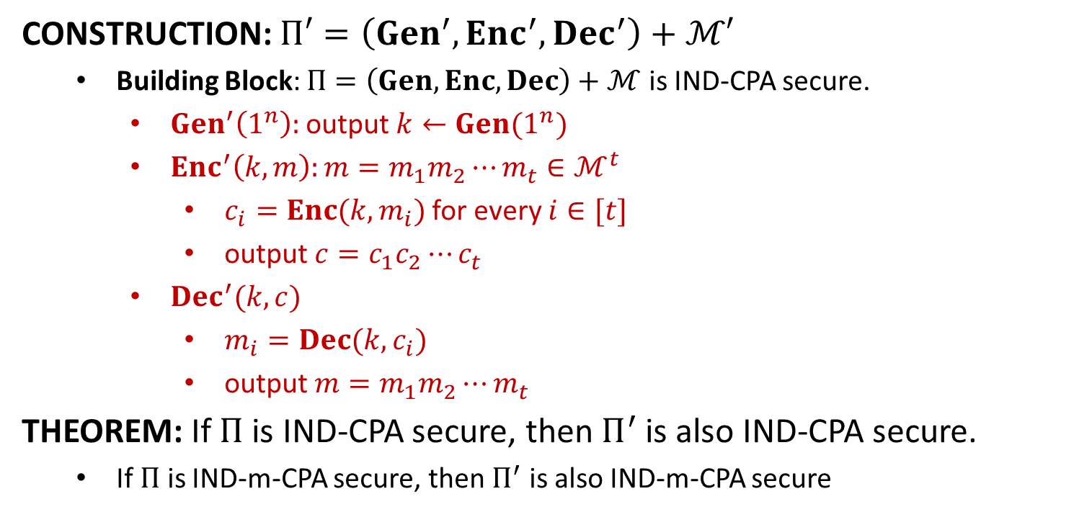
From Fixed-Length to Arbitrary-Length
CONSTRUCTION: $Π′=\left(Gen^{′}, Enc^{′}, Dec^{′}\right)+ℳ′$
Building Block: $Π=\left(Gen, Enc, Dec\right)+ℳ$ is IND-CPA secure.
$Gen^{′}\left(1^{n}\right):$ output $k←Gen(1^{n})$
$Enc^{′}\left(k,m\right):m=m_{1}m_{2}⋯m_{t}∈ℳ^{t}$
$c_{i}=Enc(k,m_{i})$ for every $i∈[t]$
output $c=c_{1}c_{2}⋯c_{t}$
$Dec^{′}(k,c)$
$m_{i}=Dec(k,c_{i})$
output $m=m_{1}m_{2}⋯m_{t}$
THEOREM: If $Π$ is IND-CPA secure, then $Π^{′}$ is also IND-CPA secure.
If $Π$ is IND-m-CPA secure, then $Π^{′}$ is also IND-m-CPA secure

Slide 4














From Fixed-Length to Arbitrary-Length
$$k←Gen\left(1^{n}\right)$$
$$b←\{0,1\}$$
$$orace access to$$
$$orace access to$$
$LR_{k,b}(⋅)$ in $Π′$
$LR_{k,b}(⋅)$ in $Π$
$$b′$$
$$b′$$
$$output 1 iff b^{′}=b$$
$$Challenger$$
IND-m-CPA $Π$
$$ℬ$$
IND-m-CPA $Π′$
$$𝒜$$

Slide 6
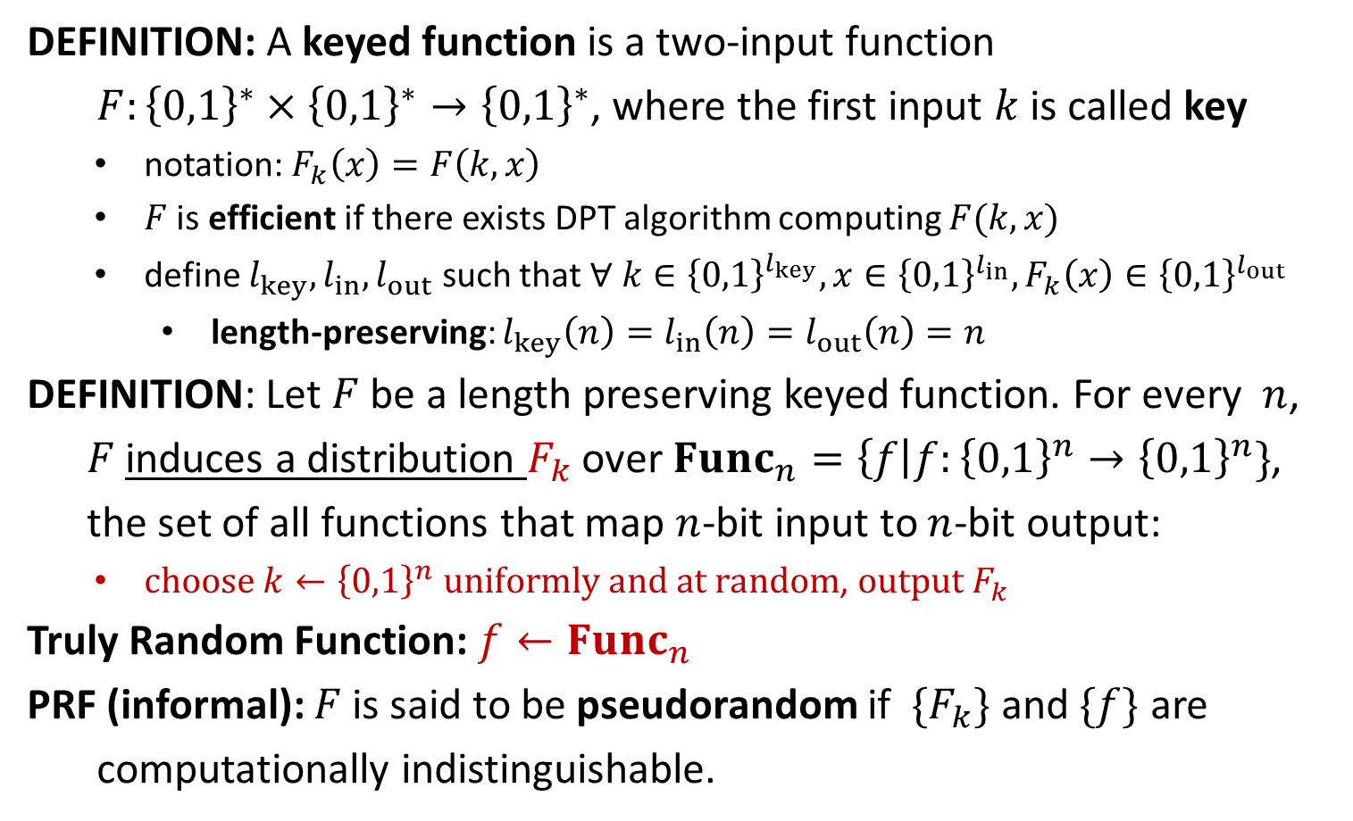
Pseudorandom Function (PRF)
DEFINITION: A keyed function is a two-input function
$F:{\left\{0,1\right\}}^{∗}×{\left\{0,1\right\}}^{∗}→{\left\{0,1\right\}}^{∗}$, where the first input $k$ is called key
notation: $F_{k}\left(x\right)=F\left(k,x\right)$
$F$ is efficient if there exists DPT algorithm computing $F(k,x)$
define $l_{key}, l_{in}, l_{out}$ such that $∀ k∈{\left\{0,1\right\}}^{l_{key}}, x∈{\left\{0,1\right\}}^{l_{in}}, F_{k}\left(x\right)∈{\left\{0,1\right\}}^{l_{out}}$
length-preserving: $l_{key}\left(n\right)=l_{in}\left(n\right)=l_{out}\left(n\right)=n$
DEFINITION: Let $F$ be a length preserving keyed function. For every $n$,
$F$ induces a distribution $F_{k}$ over $Func_{n}=\left\{f\right|f:{\left\{0,1\right\}}^{n}→{\left\{0,1\right\}}^{n}\}$,
the set of all functions that map $n$-bit input to $n$-bit output:
$choose k←{\left\{0,1\right\}}^{n} uniformly and at random$, $output F_{k}$
Truly Random Function: $f←Func_{n}$
PRF (informal): $F$ is said to be pseudorandom if $\{F_{k}\}$ and $\{f\}$ are
computationally indistinguishable.

Slide 7
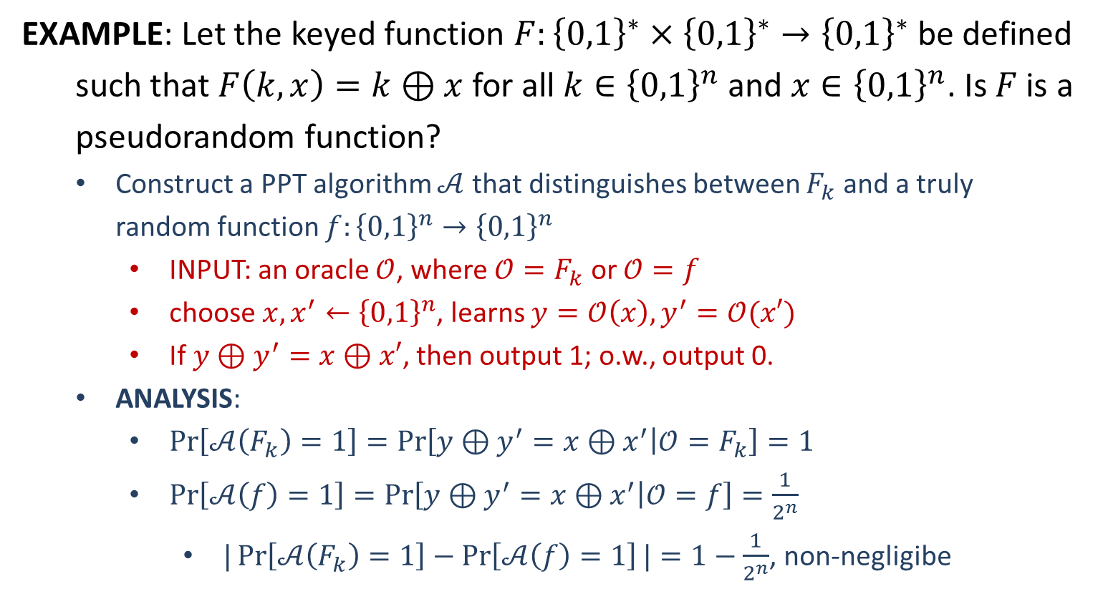
PRF
EXAMPLE: Let the keyed function $F:{\left\{0,1\right\}}^{∗}×{\left\{0,1\right\}}^{∗}→{\left\{0,1\right\}}^{∗}$ be defined
such that $F\left(k,x\right)=k⊕x$ for all $k∈{\left\{0,1\right\}}^{n}$ and $x∈{\left\{0,1\right\}}^{n}$. Is $F$ is a pseudorandom function?
Construct a PPT algorithm $𝒜$ that distinguishes between $F_{k}$ and a truly random function $f:{\left\{0,1\right\}}^{n}→{\left\{0,1\right\}}^{n}$
INPUT: an oracle $𝒪$, where $𝒪=F_{k}$ or $𝒪=f$
choose $x,x^{′}←{\left\{0,1\right\}}^{n}$, learns $y=𝒪\left(x\right), y^{′}=𝒪(x′)$
If $y⊕y^{′}=x⊕x′$, then output 1; o.w., output 0.
ANALYSIS:
$\operatorname{Pr}\left[𝒜\left(F_{k}\right)=1\right]=\operatorname{Pr}\left[y⊕y^{′}=x⊕x^{′} | 𝒪=F_{k}\right]=1$
$\operatorname{Pr}\left[𝒜\left(f\right)=1\right]=\operatorname{Pr}\left[y⊕y^{′}=x⊕x^{′} | 𝒪=f\right]=\frac{1}{2^{n}}$
$|\operatorname{Pr}\left[𝒜\left(F_{k}\right)=1\right]−\operatorname{Pr}\left[𝒜\left(f\right)=1\right]|=1−\frac{1}{2^{n}}$, non-negligibe

